Slide 1
Deep Learning for Computer Vision
Nihal Kodikara
Credits : Stanford University
MIT

Slide 2
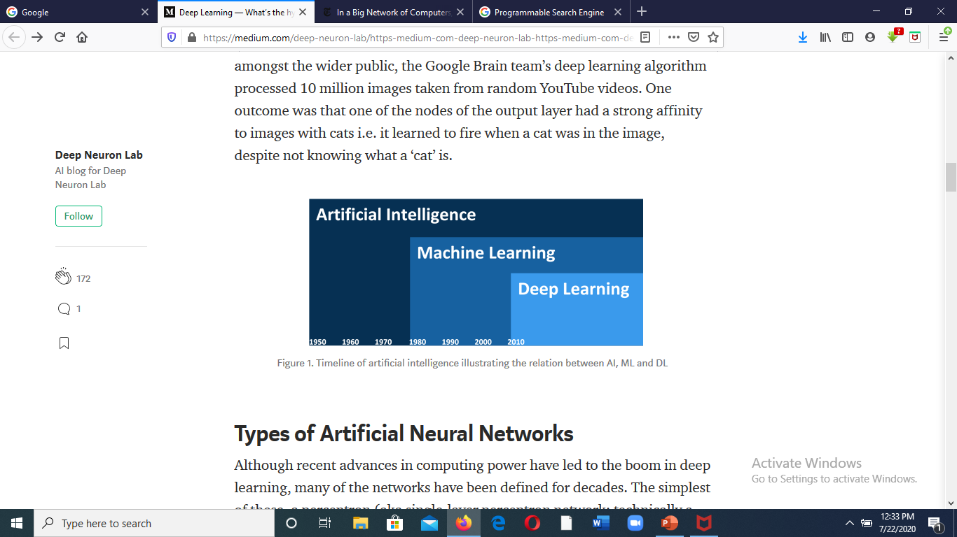

Slide 3
What Is Artificial Intelligence (AI)?
Weak (Narrow) AI
Artificial General Intelligence
Artificial Super Intelligence

Slide 4
Machine Learning
Machine learning is an application of artificial intelligence (AI) that provides systems the ability to automatically learn and improve from experience without being explicitly programmed.

Slide 5

Simple Machine Learning Example
What is the value of Y when X = 10?
Y = 2*X - 1

Slide 6



Slide 7
#line
import tensorflow as tf
from tensorflow import keras
import numpy as np
x=np.array([-1.0, 0.0, 1.0, 2.0, 3.0, 4.0], dtype=float)
y=np.array([-3.0, -1.0, 1.0, 3.0, 5.0, 7.0], dtype=float)
model=tf.keras.Sequential()
model.add(tf.keras.layers.Dense(1, input_shape=[1]))
model.compile(optimizer='sgd', loss='mean_squared_error')
model.summary()
model.fit(x, y, epochs=100)
y_p=model.predict([10.0])
print(" ")
print(" ")
print('y =',round(y_p[0][0]))

Slide 8
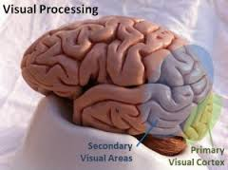

Slide 9
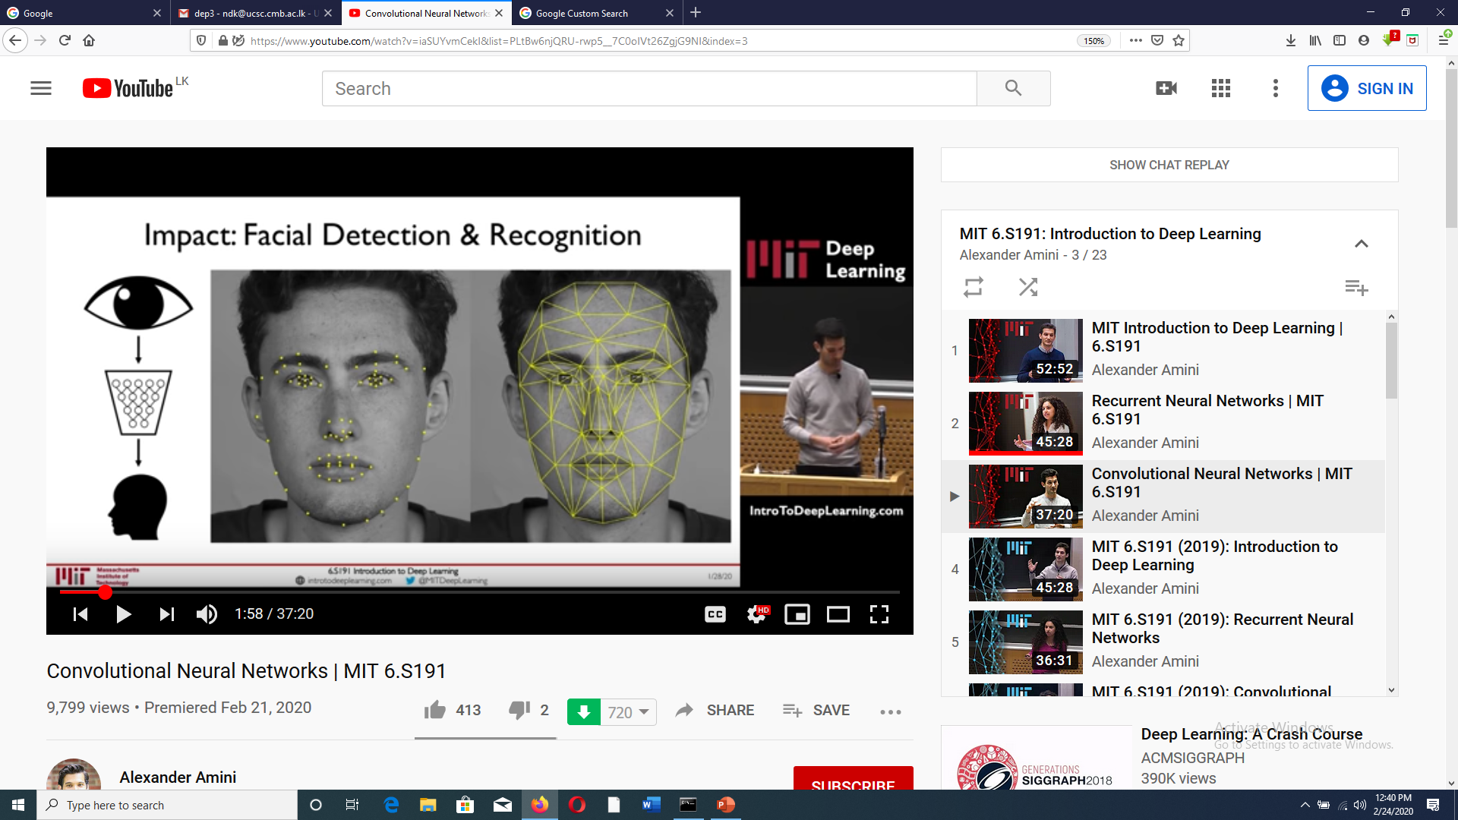

Slide 10
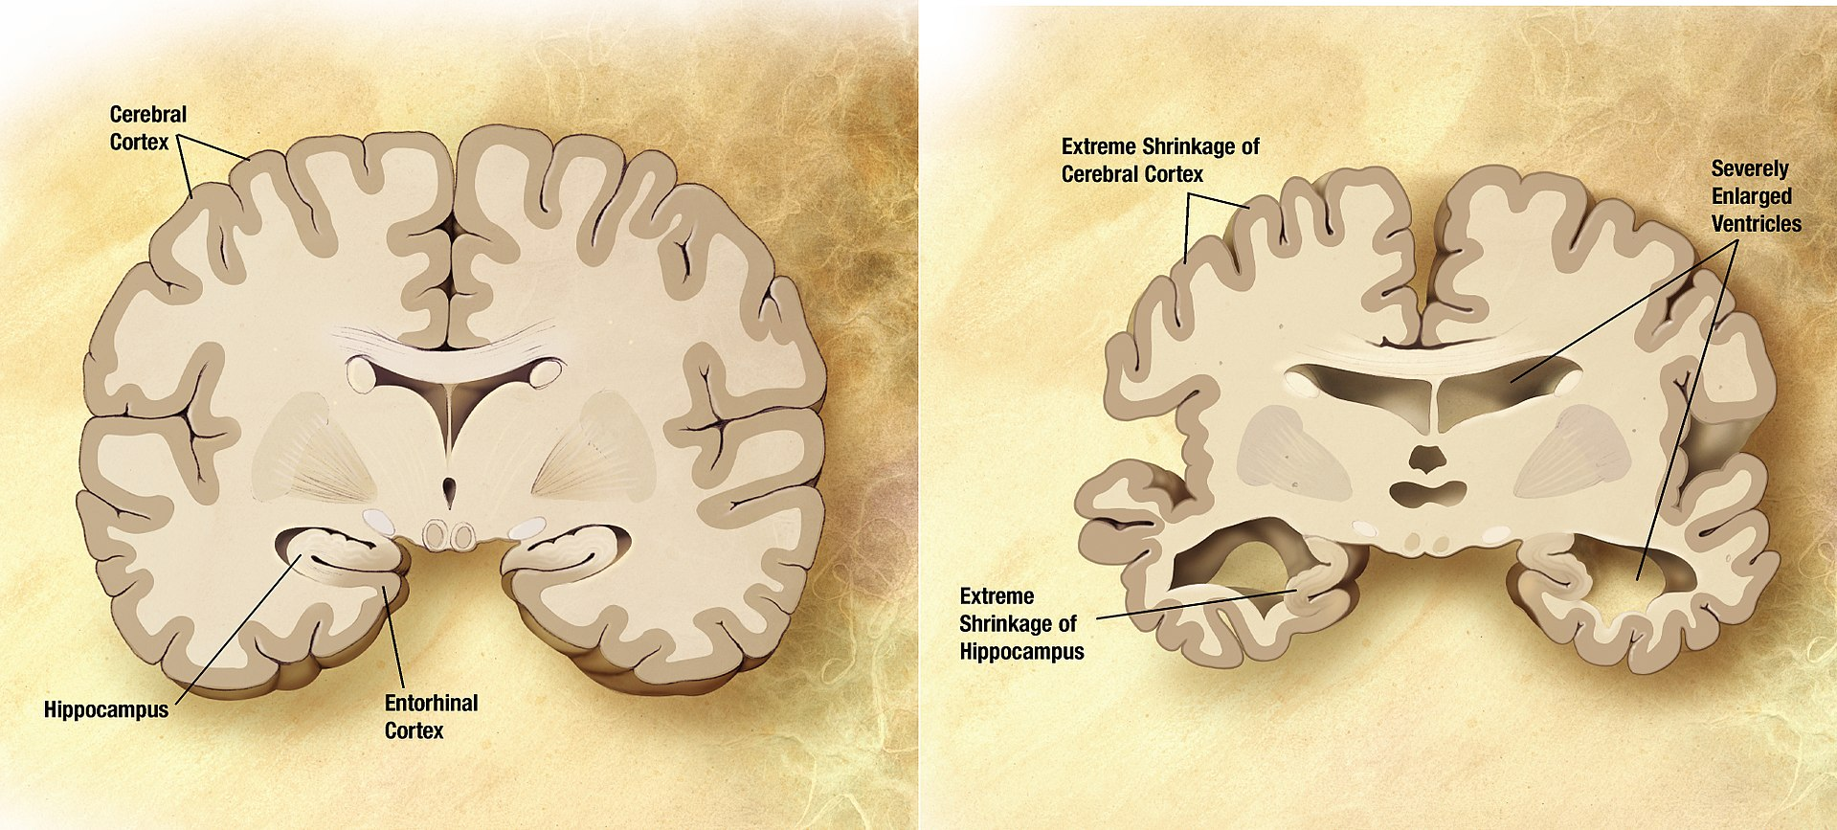
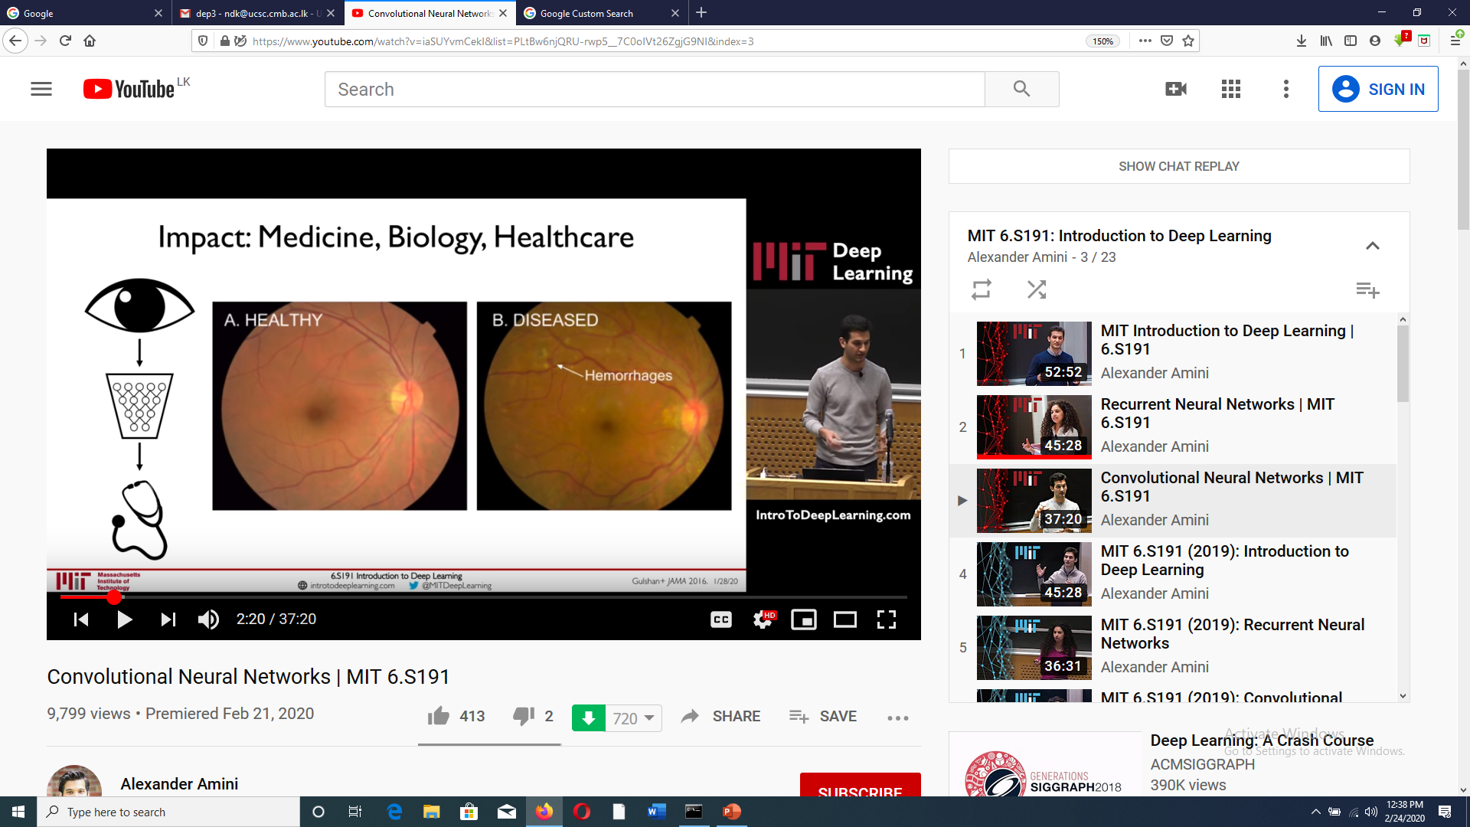
Diabetic Retinopathy Alzheimer's disease

Slide 11
Stages of processing of a typical vision system
Image capturing
Enhancement, noise removal, geometric correction etc.
Preprocessing
Edges,boundaries, angles, distances segments, shapes, colour, SIFT, SURF etc.
Feature extraction
Interpretation/recognition
Using domain knowledge

Slide 12
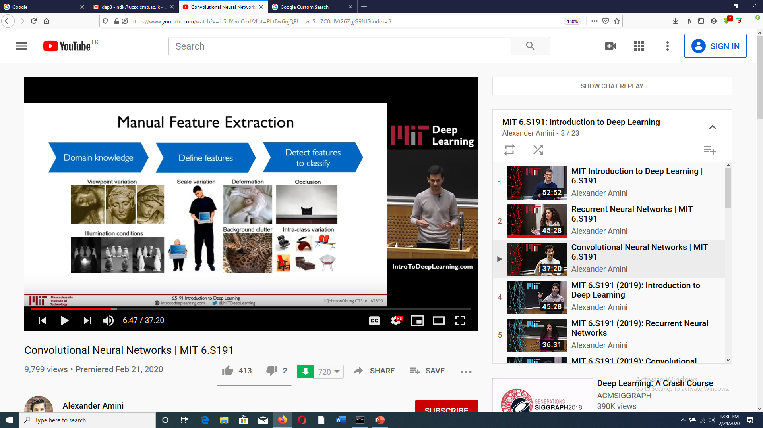

Slide 13
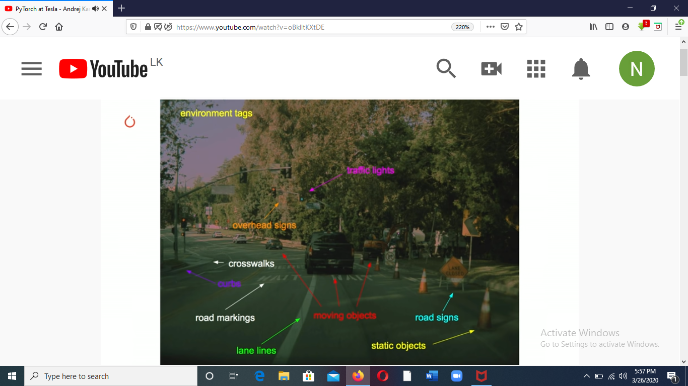

Slide 14
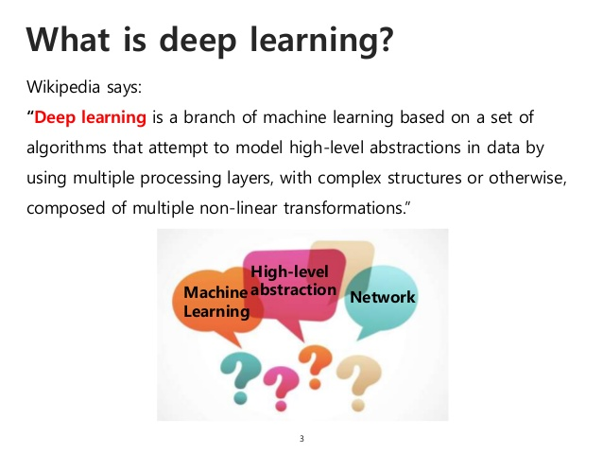

Slide 15
“Deep learning allows computational models that are composed of multiple processing layers to learn representations of data with multiple levels of abstraction.”

Slide 16
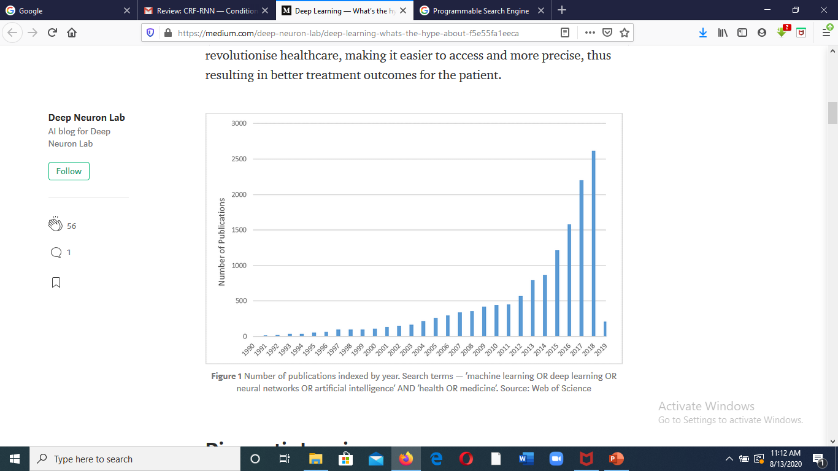

Slide 17
Is it Brand New?
Neural Networks McCuloch 1943
Recurrent Neural Networks (RNN) Grossberg 1973
Convolutional Neural Networks (CNN) Fukushima 1979
Deep Belief Networks (DBN) Hinton 2006
Generative Adversarial Networks (GAN) Goodfellow 2014
Fully Convolutional Networks (FCN) Long 2015
Transformers
https://arxiv.org/pdf/1706.03762.pdf

Slide 18
DL Libraries
2002 – Torch Facebook AI Reseach Group
2008 - Theano Montrial Uni AI Group
2014 - Caffe Berkeley AI Research
2014 – Mxnet Apache
2015 - Tensorflow 1.0 Google
2017 - PyTorch 1.0
2019 - Tensorflow 2.0
2019 - Keras Google
2021 – Tensorflow 2.4.0
https://playground.tensorflow.org

Slide 19
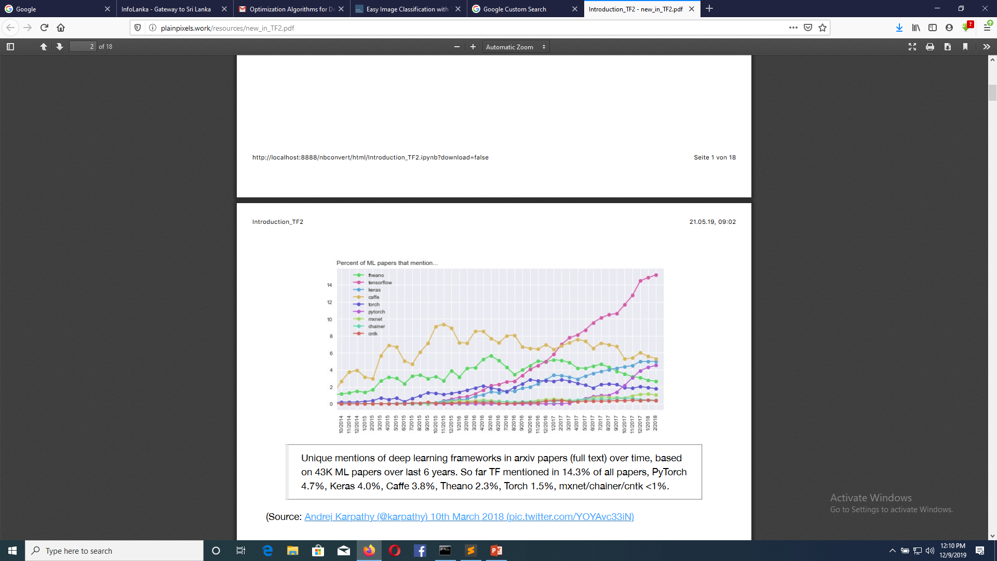

Slide 20
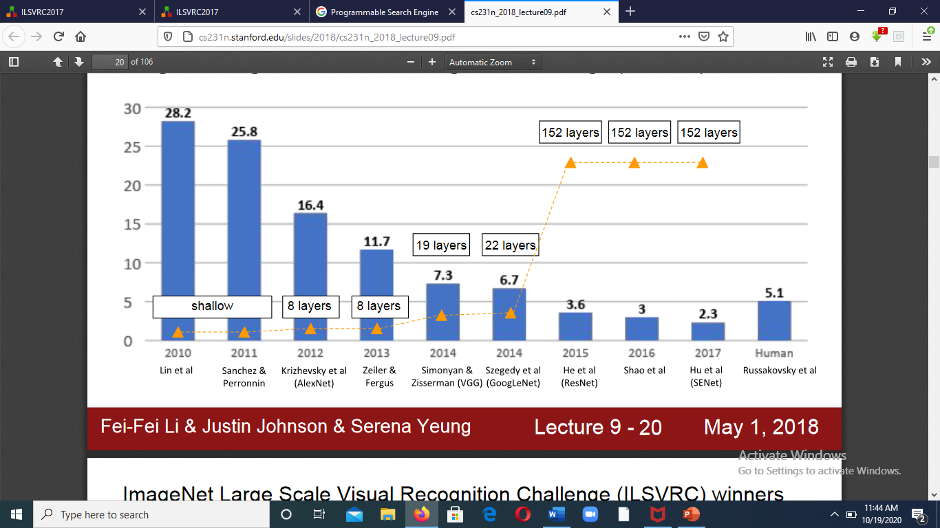
Image-Net Large Scale Visual Recognition Challenge (ILSVRC)
Recognition error rate %

Slide 21
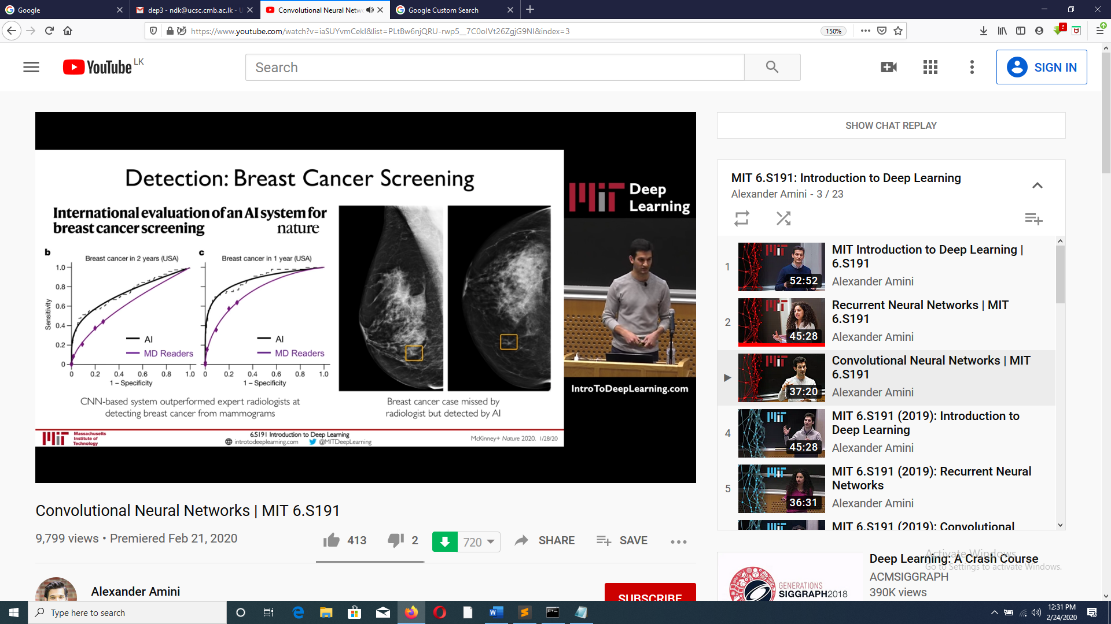

Slide 22
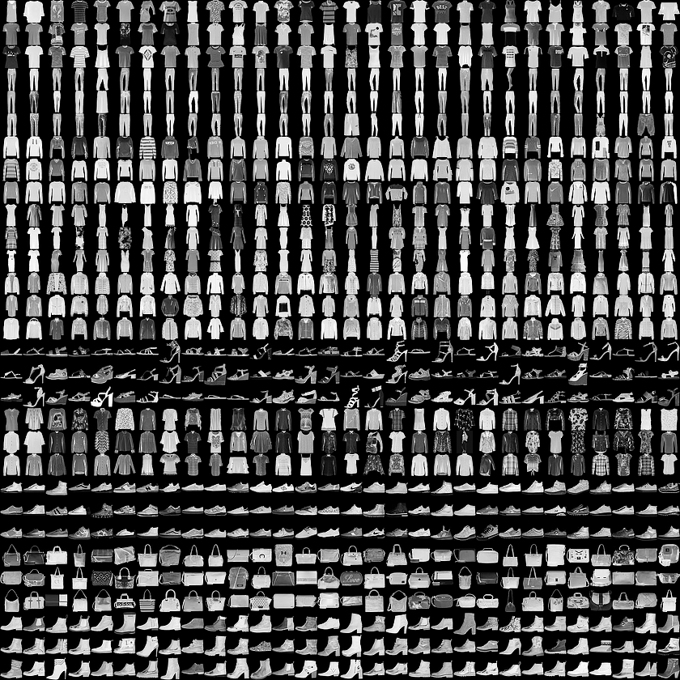
Simple Image Classifier without convolution
Data Set - Fashion MNIST dataset which contains 70,000 grayscale images of fashion clothing in 10 categories. The images show individual articles of clothing at low resolution (28 by 28 pixels)
60,000 – Training images and 10,000 Testing images.
class_names = ['T-shirt/top', 'Trouser', 'Pullover', 'Dress', 'Coat', 'Sandal', 'Shirt', 'Sneaker', 'Bag', 'Ankle boot']

Slide 23
Input
ReLu
Output (Softmax)
.
.
.
.
.
.
.
.
.
.
.
.
.
.
.
.
.
.
.
28x28 image
128 neurons
10 Fasion items
784 elements
keras.layers.Flatten(input_shape=(28, 28)),
keras.layers.Dense(128, activation='relu'),
keras.layers.Dense(10, activation='softmax')

Slide 24
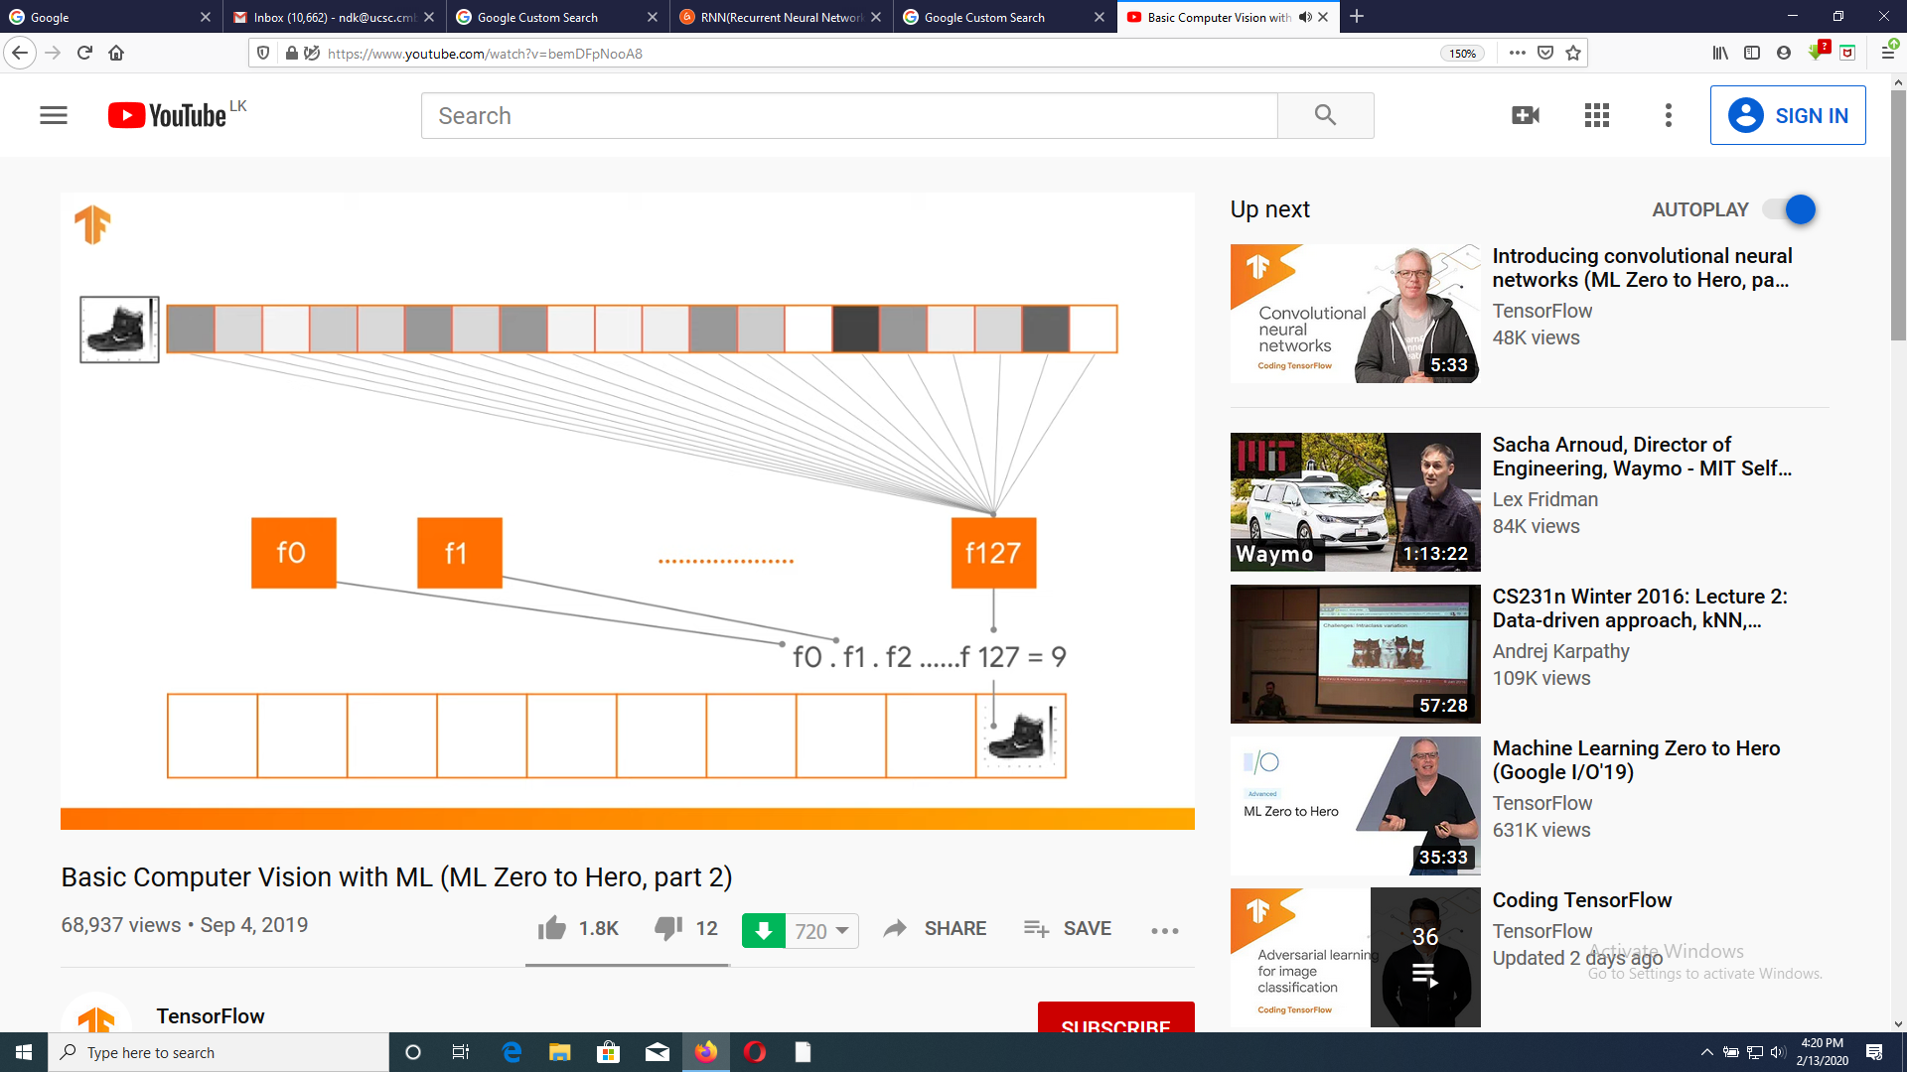

Slide 25
Working Environment
Install python 3.6 + (64 bit version) from www.python .org
2. In command line
pip install tensorflow

Slide 26

ReLu Activation function
The purpose of the activation function is to introduce non-linearity into our network. Since our input data is non-linear , our model needs to account for that. To do so, we use the Rectified Linear Unit (ReLU) activation function:
The ReLu function is quite simple; values that are less than or equal to zero become zero and all positive values remain the same.

Slide 27
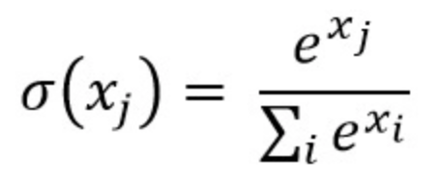
Softmax Function
The output layer is in charge of producing the probability of each class given the input image. To obtain these probabilities, initialize the final Dense layer to contain the same number of neurons as there are classes. The output of this dense layer then passes through the Softmax activation function, which maps all the final dense layer outputs to a probability distribution of a list of potential outcome with a vector whose elements sum up to one:
Score
x1=2.0
x2=1.0
x3=0.1
Probabilities
p1=0.7
p2=0.2
3=0.1
Where x denotes each element in the final layer’s outputs.

Slide 28
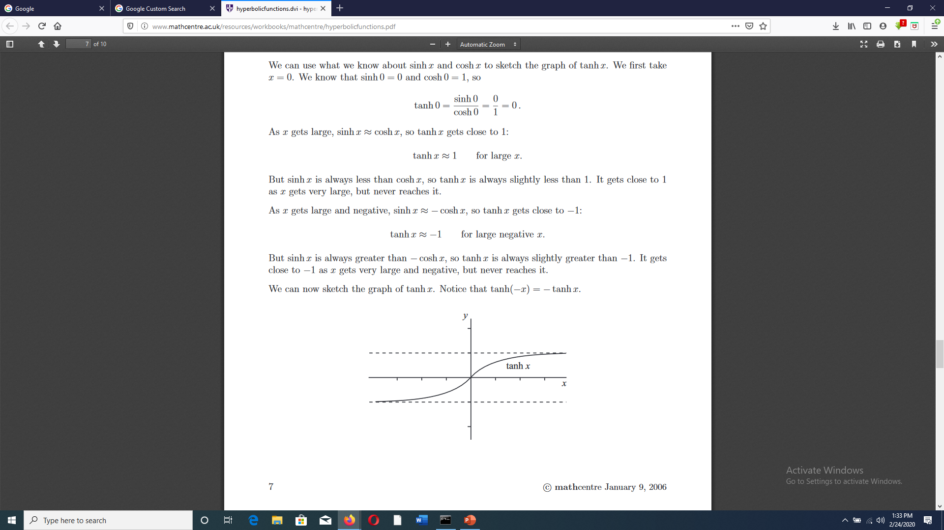
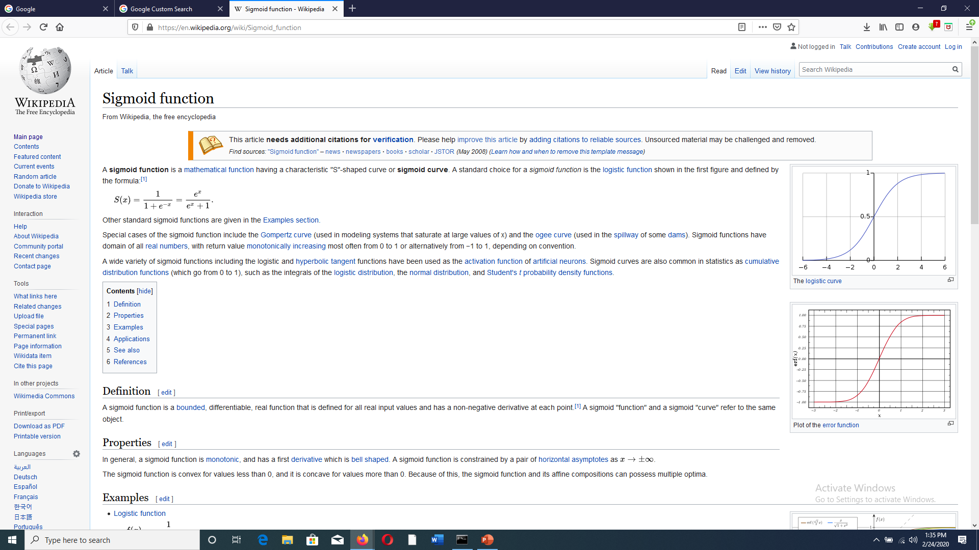
Other Activation Functions
tanh(x) = sinh(x)/cosh(x) = ((exp(x) - exp(-x))/(exp(x) + exp(-x)))
● Tanh
● Sigmoid
tf.keras.activations.tanh(x)
Sigmoid(x) = (1.0 / (1.0 + exp(-x)))
tf.keras.activations.sigmoid(x))

Slide 29
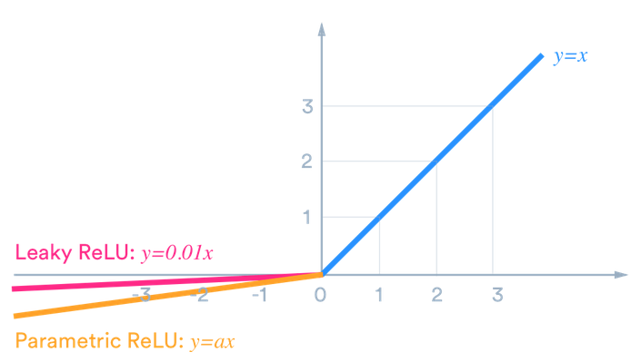
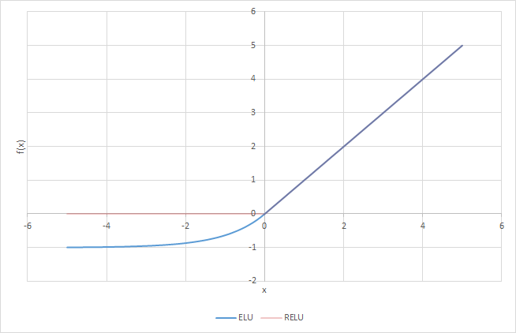
Other Activation Functions
● Leaky Relu
● ELU (Exponential Linear Unit)
ELU(x) = alpha * (exp(x) - 1.) for x < 0, f(x) = x for x >= 0
LR(x) = alpha * x for x < 0, f(x) = x for x >= 0.
tf.keras.layers.LeakyReLU(alpha=0.3)
tf.keras.layers.ELU(alpha=1.0)

Slide 30
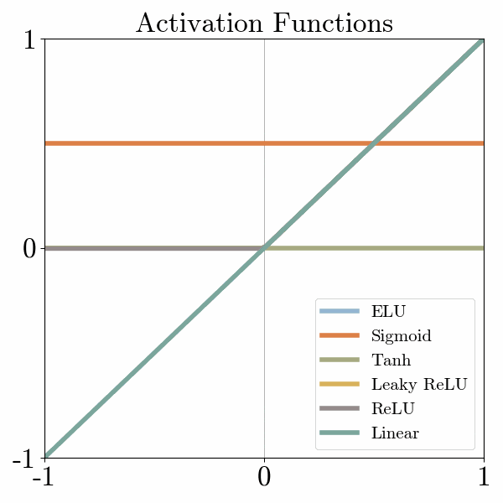

Slide 31
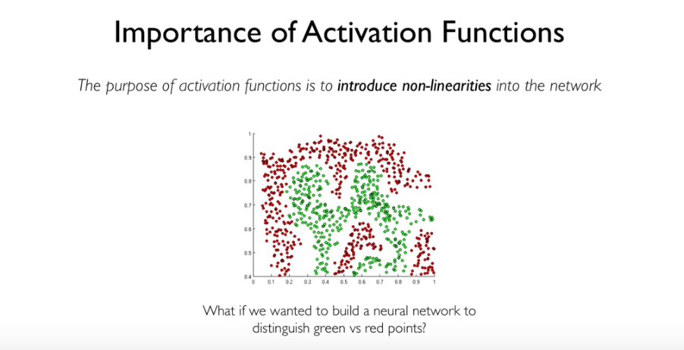

Slide 32
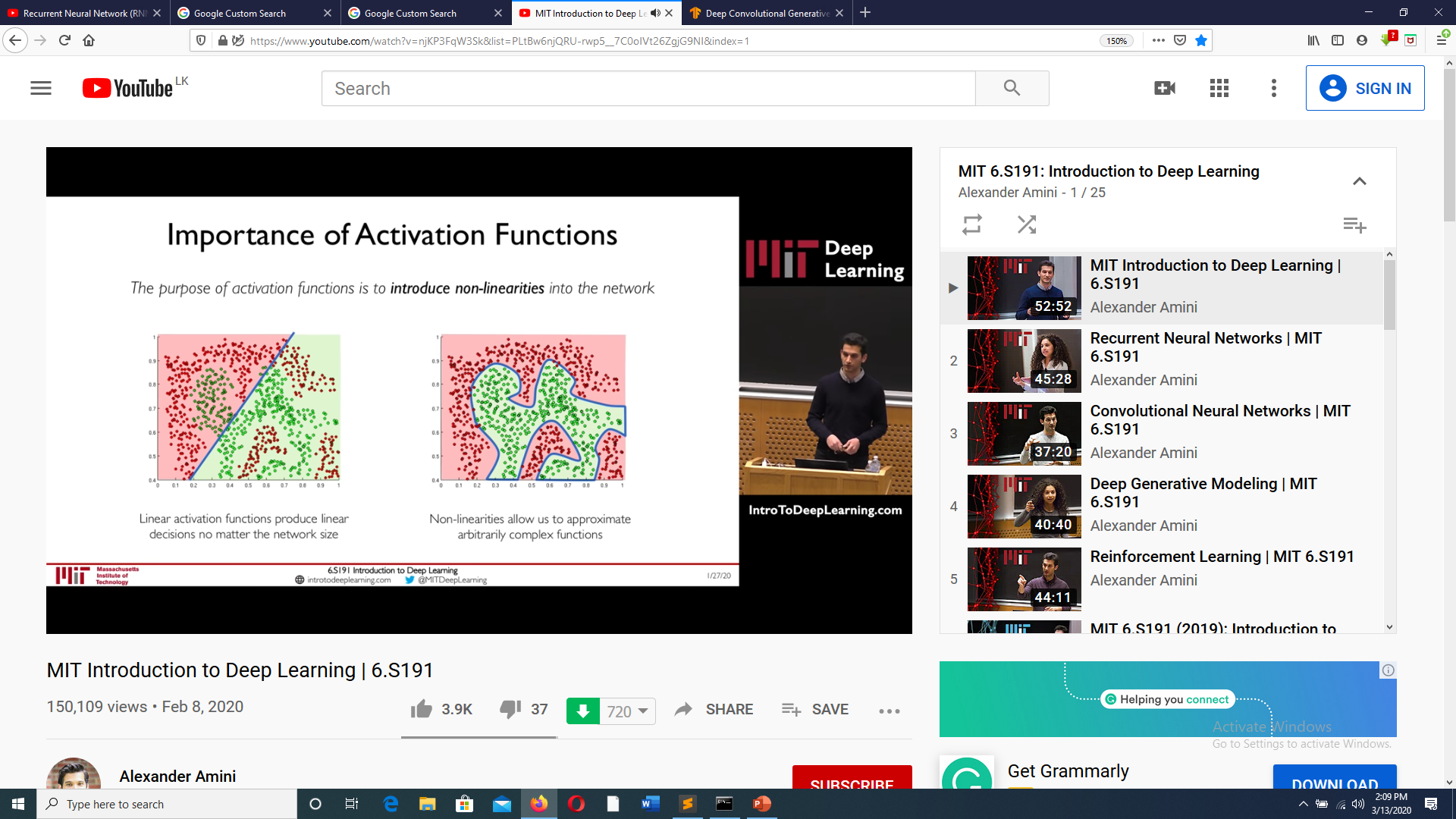

Slide 33
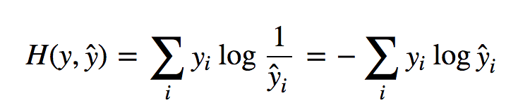
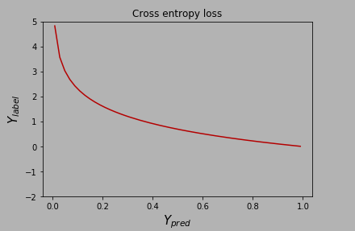
Calculating the Loss
To measure how accurate our network was in predicting the handwritten digit from the input image, we make use of a loss function. The loss function assigns a real-valued number to define the model’s accuracy when predicting the output digit. A common loss function to use when predicting multiple output classes is the Categorical Cross-Entropy Loss function, defined as follows:
Here, ŷ is the Network’s prediction, and y is the desired output label.

Slide 34
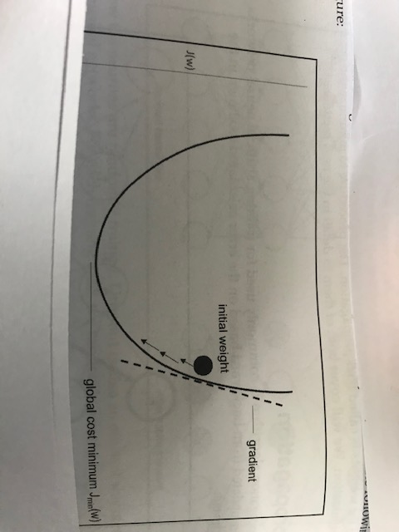
Gradient Descent
The Gradient Descent algorithm performs multidimensional optimization. The objective is to reach the global minimum of the loss function. It is used to improve or optimize the model prediction.

Slide 35
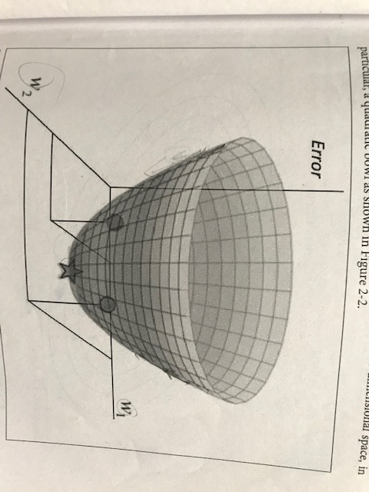
Gradient Descent with 2 parameters

Slide 36
Hubel, D. H.; Wiesel, T. N. (1959). "Receptive fields of single neurones in the cat's striate cortex". The Journal of Physiology. 124 (3): 574–591.
Findings
Different neurons in the visual cortex responds to different types of features.
Visual cortex processes an image region by region not the entire image
Visual process takes place on overlapping segments of an image.

Slide 37
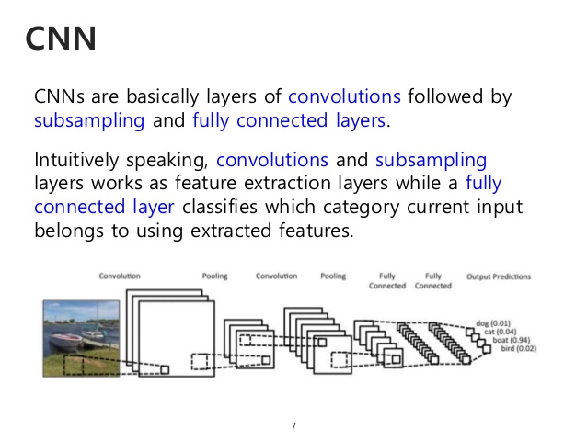
Kunihiko Fukushima, "Neocognitron: A Self-organizing Neural Network Model for a Mechanism of Pattern Recognition Unaffected by Shift in Position“
Biological Cybernetics, 1980, 36(4), pp 193-202 (PDF). Biological Cybernetics. 36 (4): 193–202.

Slide 38
Convolution
The convolution of two functions f(x) and g(x), denoted by f(x)*g(x), is defined by the integral
f(x)*g(x) = ∫ f( α) g(x -α ) d α
The convolution of two functions f(x,y) and g(x,y), denoted by f(x,y)*g(x,y), is defined by the integral
f(x,y)*g(x,y) = ∫ ∫ f( α ,β) g(x -α , y -β ) d α d β
∞
-∞
∞
∞
-∞
-∞

Slide 39
Discrete Convolution
If f(x) and g(x) are two functions defined on x=0…n-1. Then the discrete convolution is defined as
n-1
f(x)*g(x) =1/n ∑ f(α ) g(x- α )
α =0
If f(x,y) g(x,y) are defined over x=0….n-1, y=0…m-1 The discrete convolution is given by
n-1 m-1
f(x,y)*g(x,y) =1/mn ∑ ∑ f(α,β ) g(x+ α, y+ β)
α =0 β =0

Slide 40
Convoluting a 3x3 filter
45 | 47 | 46 | 47 | 48
47 | 50 | 47 | 48 | 47
47 | 47 | 48 | 50 | 49
44 | 48 | 47 | 47 | 50
43 | 46 | 47 | 56 | 48
1 | 0 | -1
1 | 0 | -1
1 | 0 | -1
M
F
If the image F is convoluted with the filter M what is the value of the shaded pixel?

Slide 41
-1 | 2 | -1
-1 | 2 | -1
-1 | 2 | -1
-1 | -1 | -1
2 | 2 | 2
-1 | -1 | -1
-1 | 0 | 1
-2 | 0 | 2
-1 | 0 | 1
-1 | -1 | 2
-1 | 2 | -1
-1 | 2 | -1
Vertical lines horizontal lines horizontal edges curve

Slide 42
Convolutions
CNN’s make use of filters (also known as kernels), to detect what features, such as edges, are present throughout an image. A filter is just a matrix of values, called weights, that are trained to detect specific features. The filter moves over each part of the image to check if the feature it is meant to detect is present.

Slide 43
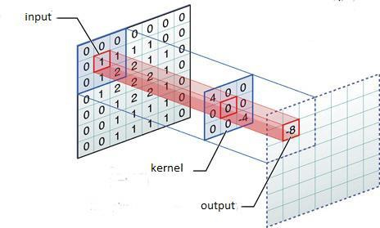
When the feature is present in part of an image, the convolution operation between the filter and that part of the image results in a real number with a high value. If the feature is not present, the resulting value is low.

Slide 44


Slide 45
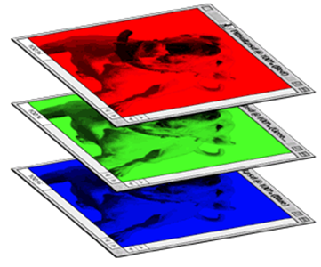
Color image: RGB 3 channels
1 | -1 | -1
-1 | 1 | -1
-1 | -1 | 1
-1 | 1 | -1
-1 | 1 | -1
-1 | 1 | -1
1 | -1 | -1
-1 | 1 | -1
-1 | -1 | 1
-1 | 1 | -1
-1 | 1 | -1
-1 | 1 | -1
1 | -1 | -1
-1 | 1 | -1
-1 | -1 | 1
-1 | 1 | -1
-1 | 1 | -1
-1 | 1 | -1
Filter 1
Filter 2
Color image
1 | 0 | 0 | 0 | 0 | 1
0 | 1 | 0 | 0 | 1 | 0
0 | 0 | 1 | 1 | 0 | 0
1 | 0 | 0 | 0 | 1 | 0
0 | 1 | 0 | 0 | 1 | 0
0 | 0 | 1 | 0 | 1 | 0
1 | 0 | 0 | 0 | 0 | 1
0 | 1 | 0 | 0 | 1 | 0
0 | 0 | 1 | 1 | 0 | 0
1 | 0 | 0 | 0 | 1 | 0
0 | 1 | 0 | 0 | 1 | 0
0 | 0 | 1 | 0 | 1 | 0
1 | 0 | 0 | 0 | 0 | 1
0 | 1 | 0 | 0 | 1 | 0
0 | 0 | 1 | 1 | 0 | 0
1 | 0 | 0 | 0 | 1 | 0
0 | 1 | 0 | 0 | 1 | 0
0 | 0 | 1 | 0 | 1 | 0

Slide 46
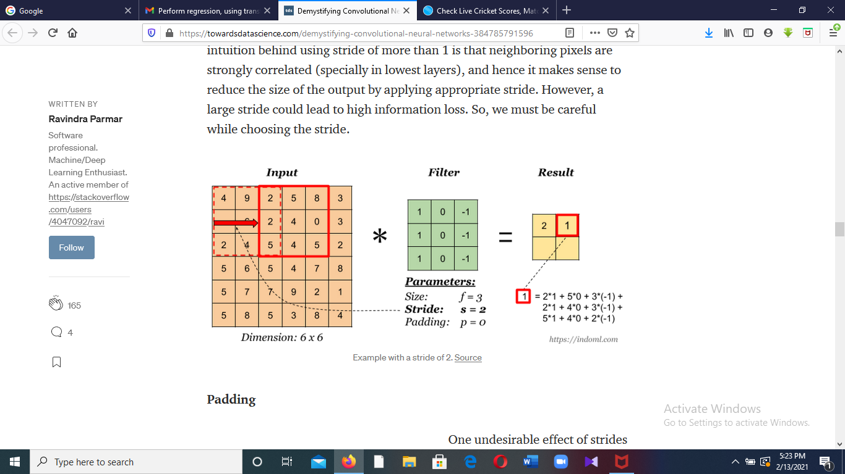
Strided Convolution

Slide 47
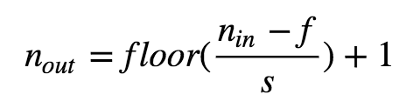
Additionally, a filter can be slid over the input image at varying intervals, using a stride value. The stride value dictates by how much the filter should move at each step. The output dimensions of a strided convolution can be calculated using the following equation:
Where n_{in} denotes the dimension of the input image, f denotes the filter size, and s denotes the stride.
Eg: if n_{in}=7 and f=3
Stride (s) =1 → n_{out} =(7-3)/1 + 1 =5
Stride (s) =2 → n_{out} =(7-3)/2 +1 = 3
Stride (s) =4 → n_{out} =(7-3)/3 + 1 = 2.33

Slide 48
In practice, common to zero pad the border
If the input is 7x7 a 3x3 filter is applied with stride =1
pad with 1 pixel border what is the size of the output?
0 | 0 | 0 | 0 | 0 | 0 | 0 | 0
0 |  |  |  |  |  |  | 0
0 |  |  |  |  |  |  | 0
0 |  |  |  |  |  |  | 0
0 |  |  |  |  |  |  | 0
0 |  |  |  |  |  |  | 0
0 |  |  |  |  |  |  | 0
0 | 0 | 0 | 0 | 0 | 0 | 0 | 0
Answer 7x7
In general, common to see Conv layers with stride=1, filters of size FxF are zero padding with (F-1)/2 which will preserve size spatially
eg. F=3 → zero pad with 1
F=5 → zero pad with 2
F=7 → zero pad with 3

Slide 49
Question
Input volume 32x32x3 , applying 10 5x5 filters with stride 1 , padding 2 what is the output volume?
(36-5)/1 +1 =32
Output volume =32x32x10
Question
How many parameters in this layer?
Each filter has 5x5x3 +1 =76 parameters
(+1 for bias)
Number of parameters = 76x10 =760

Slide 50
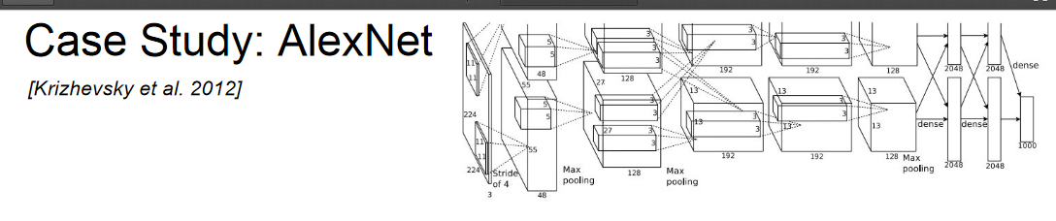
Input size 227x227x3
In the first layer (conv1) 96, 11x11 filters were applied with stride 4
What is the size of the output volume?
Output image size =(227-11)/4 +1 =55
Output volume = 55x55x96
How many parameters in this layer?
((11x11x3)+1)x96 = 34,944

Slide 51
Summary
To summarize the Conv Layer
Accepts a volume size W₁ x H₁ xD₁
Requires four hyperparameters
. Number of Filters K
. The stride S
. The filter size F
. The amount od zero padding P
Produces a volume of size W2 x H2 x D2 where
W₂ = (W₁-F+2P)/S + 1
H₂ = (H₁-F+2P)/S +1
D₂ = K
With parameter sharing it introduces F.F.D1 weights per filter for total of (F.F.D1). K weights and K biases
Common settings
- F=3, S=1, P=1
- F=5, S=1, P=2
- F=5,S=2, P=? (whatever fits)

Slide 52
Downsampling (Pooling)
To speed up the training process and reduce the amount of memory consumed by the network, we try to reduce the redundancy present in the input feature. There are a couple of ways we can downsample an image, the most common one: max pooling.
In max pooling, a window passes over an image according to a set stride (how many units to move on each pass). At each step, the maximum value within the window is pooled into an output matrix, hence the name max pooling.

Slide 53
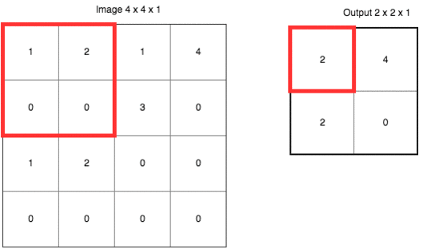
Maxpooling
In the following visual, a window of size f=2 passes over an image with a stride of 2. At each step, the maximum value within the window is chosen:
Max pooling significantly reduces the representation size, in turn reducing the amount of memory required and the number of operations performed later in the network.
An added benefit of max pooling is that it forces the network to focus on a few neurons instead of all of them which has a regularizing effect on the network, making it less likely to overfit the training data and hopefully generalize well.

Slide 54
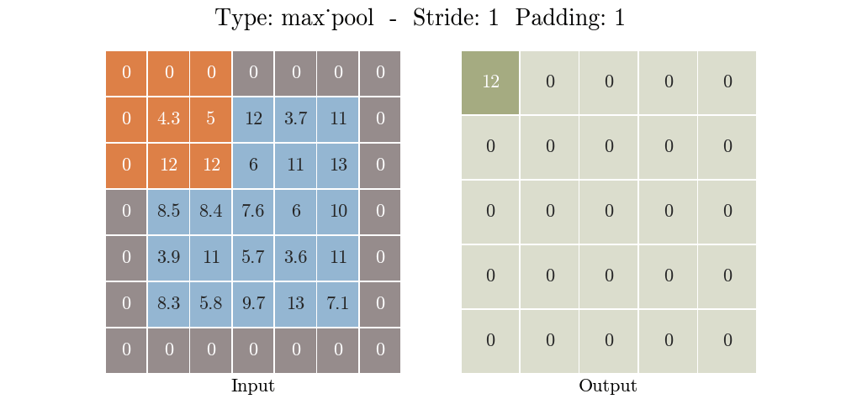

Slide 55
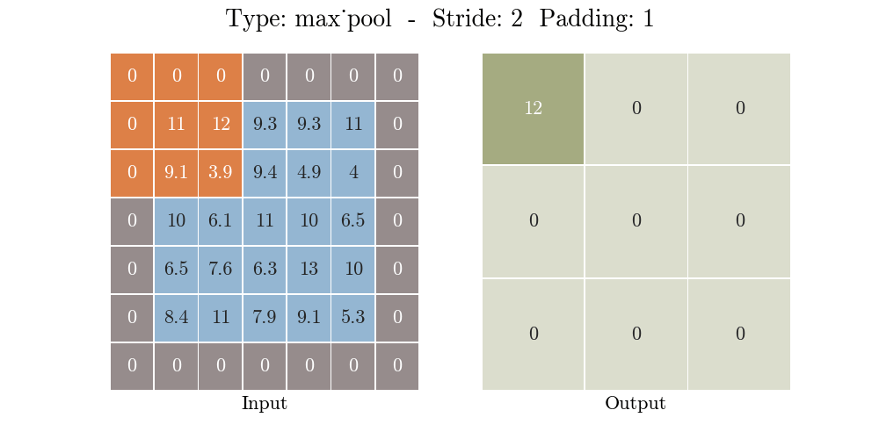

Slide 56
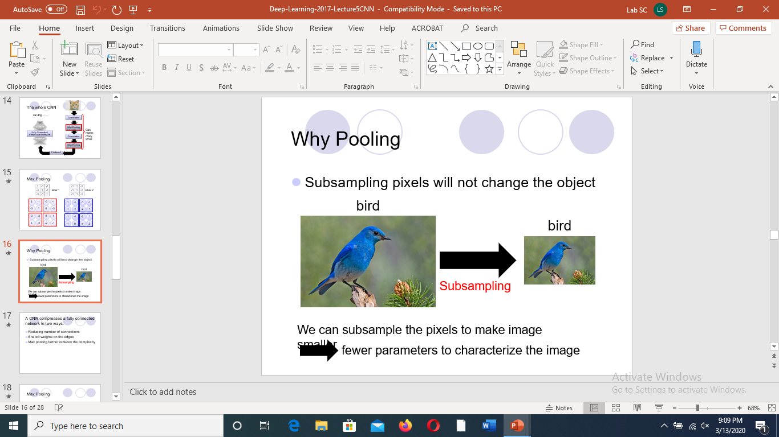

Slide 57

From towardsdatascience.com

Slide 58
Fully Connected Layer
After multiple convolutional layers and downsampling operations, the 3D image representation is converted into a feature vector that is passed into a Multi-Layer Perceptron, which merely is a neural network with at least three layers. This is referred to as a Fully-Connected Layer.
In the fully-connected operation of a neural network, the input representation is flattened into a feature vector and passed through a network of neurons to predict the output probabilities. The following image describes the flattening operation:

Slide 59
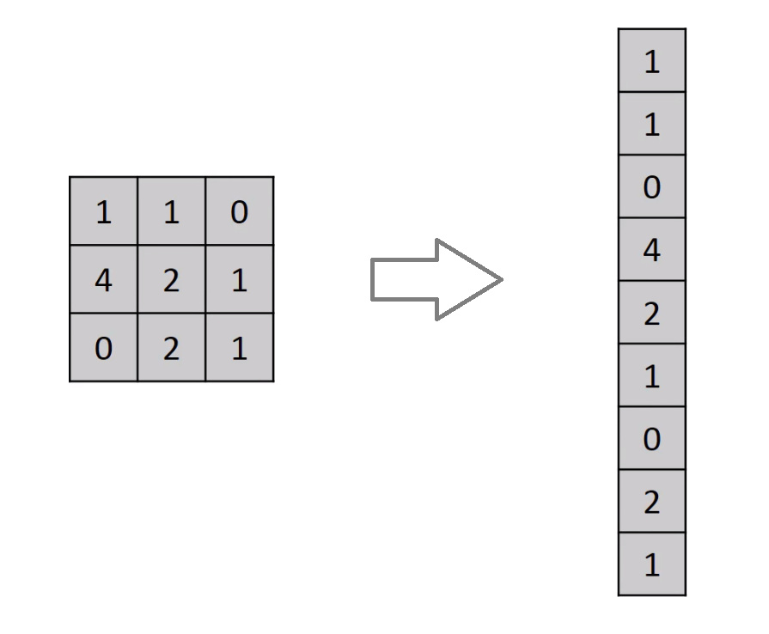
flattening operation
The rows are concatenated to form a long feature vector. If multiple input layers are present, its rows are also concatenated to form an even longer feature vector.

Slide 60
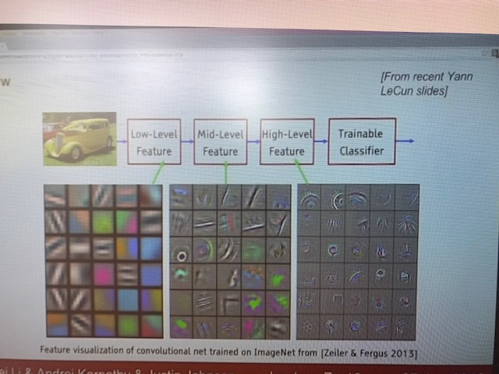

Slide 61
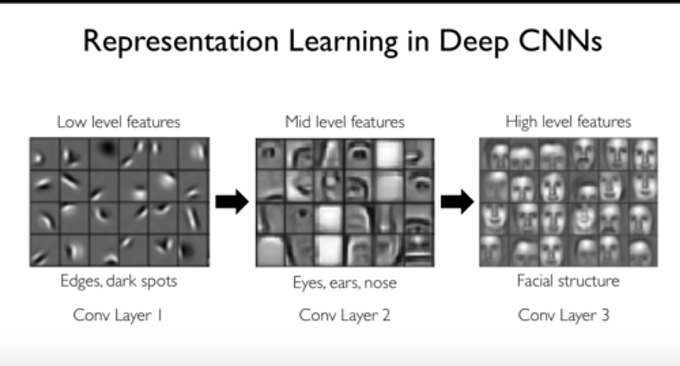

Slide 62
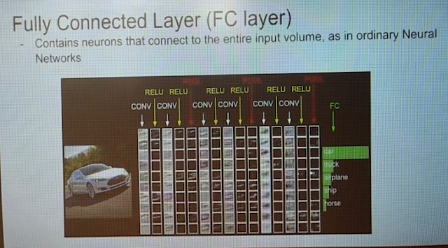

Slide 63
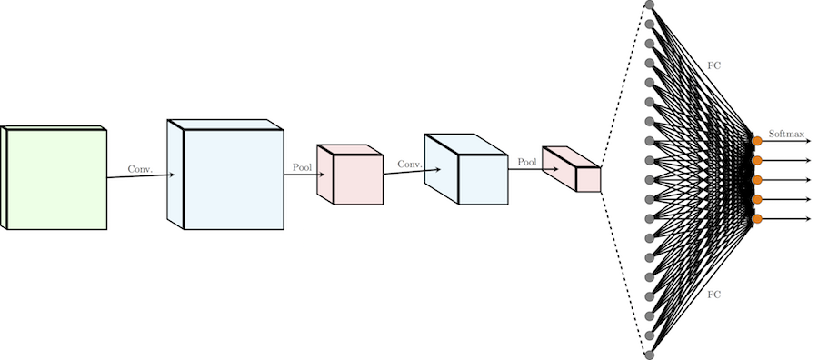
Fully Connected Layers
The feature vector is then passed through multiple dense layers. At each dense layer, the feature vector is multiplied by the layer’s weights, summed with its biases, and passed through a non-linearity.
The following image visualizes the fully connected operation and dense layers:

Slide 64
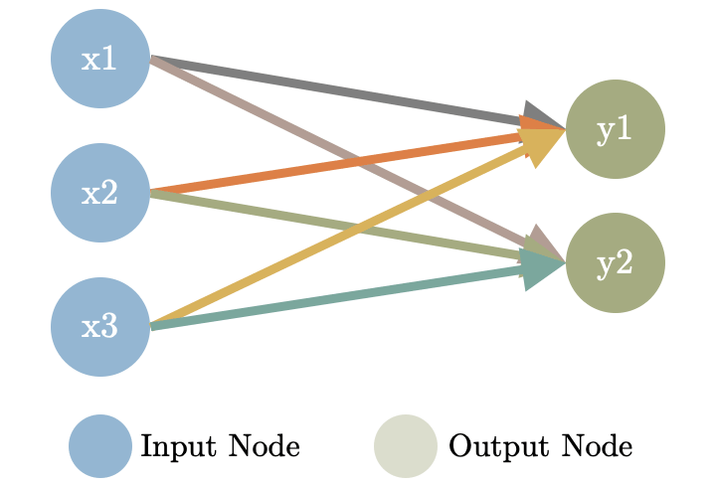
Fully Connected Layers:
These layers consist of linear functions between the input and the output. For i input nodes and j output nodes, the trainable weights are wij and bj. The figure on the left illustrates how a fully connected layer between 3 input and 2 output nodes work.

Slide 65
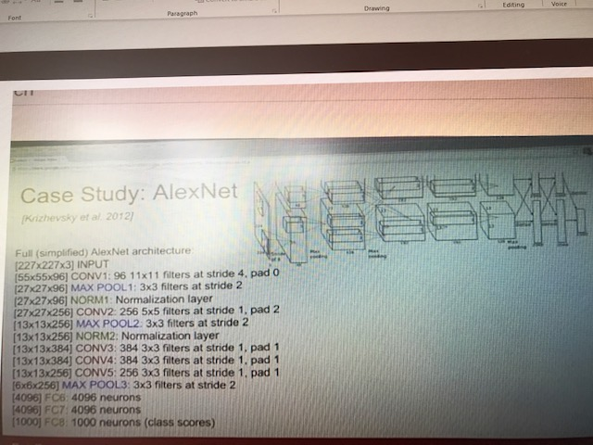

Slide 66
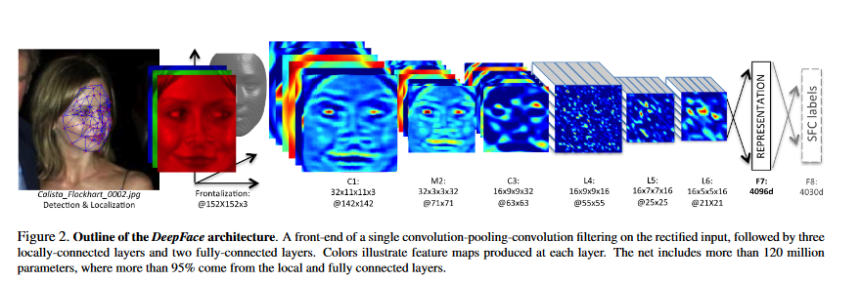
DeepFace - by Facebook AI Research
Face Recognition - Accuracy 97.35
Yaniv Taigman etel - “DeepFace: Closing the Gap to Human-Level Performance in Face Verification”, CVPR 2014

Slide 67
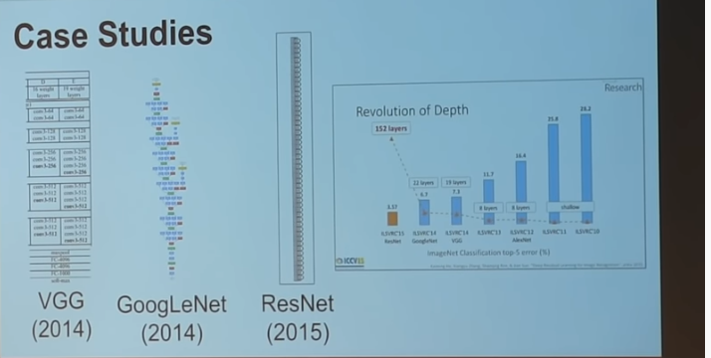

Slide 68
Example - Build a CNN Model using Tensorflow2.0 and Keras
The CIFAR-10 dataset
The CIFAR-10 dataset consists of 60000 32x32 colour images in 10 classes, with 6000 images per class. There are 50000 training images and 10000 test images. The dataset is divided into five training batches and one test batch, each with 10000 images. The test batch contains exactly 1000 randomly-selected images from each class. The training batches contain the remaining images in random order, but some training batches may contain more images from one class than another. Between them, the training batches contain exactly 5000 images from each class. Here are the classes in the dataset, as well as 10 random images from each:
https://www.cs.toronto.edu/~kriz/cifar.html

Slide 69
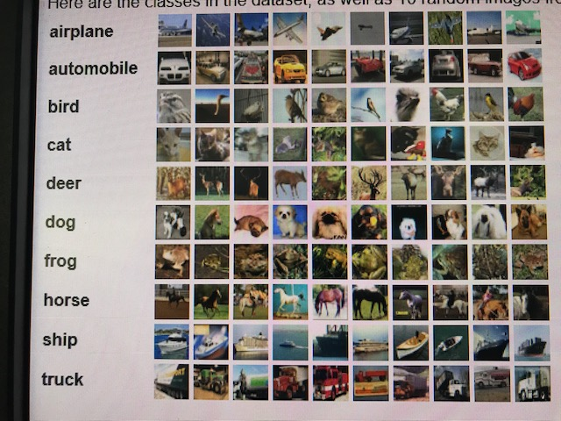

Slide 70
Image ( 32,32,3)
Conv2D (64, (3,3), “relu”)
Maxpooling (2,2)
Conv2D ( 128,(3,3), “relu”)
Maxpoling (2,2)
Conv2D (64, (3,3), “relu”)
Flatten (128)
Relu (64)
Softmax (10)

Slide 71
The 5-Step Model Life-Cycle
A model has a life-cycle, and this very simple knowledge provides the backbone for both modeling a dataset and understanding the tf.keras API.
The five steps in the life-cycle are as follows:
Define the model.
2. Compile the model.
3. Fit the model.
4. Evaluate the model.
5. Make predictions.

Slide 72
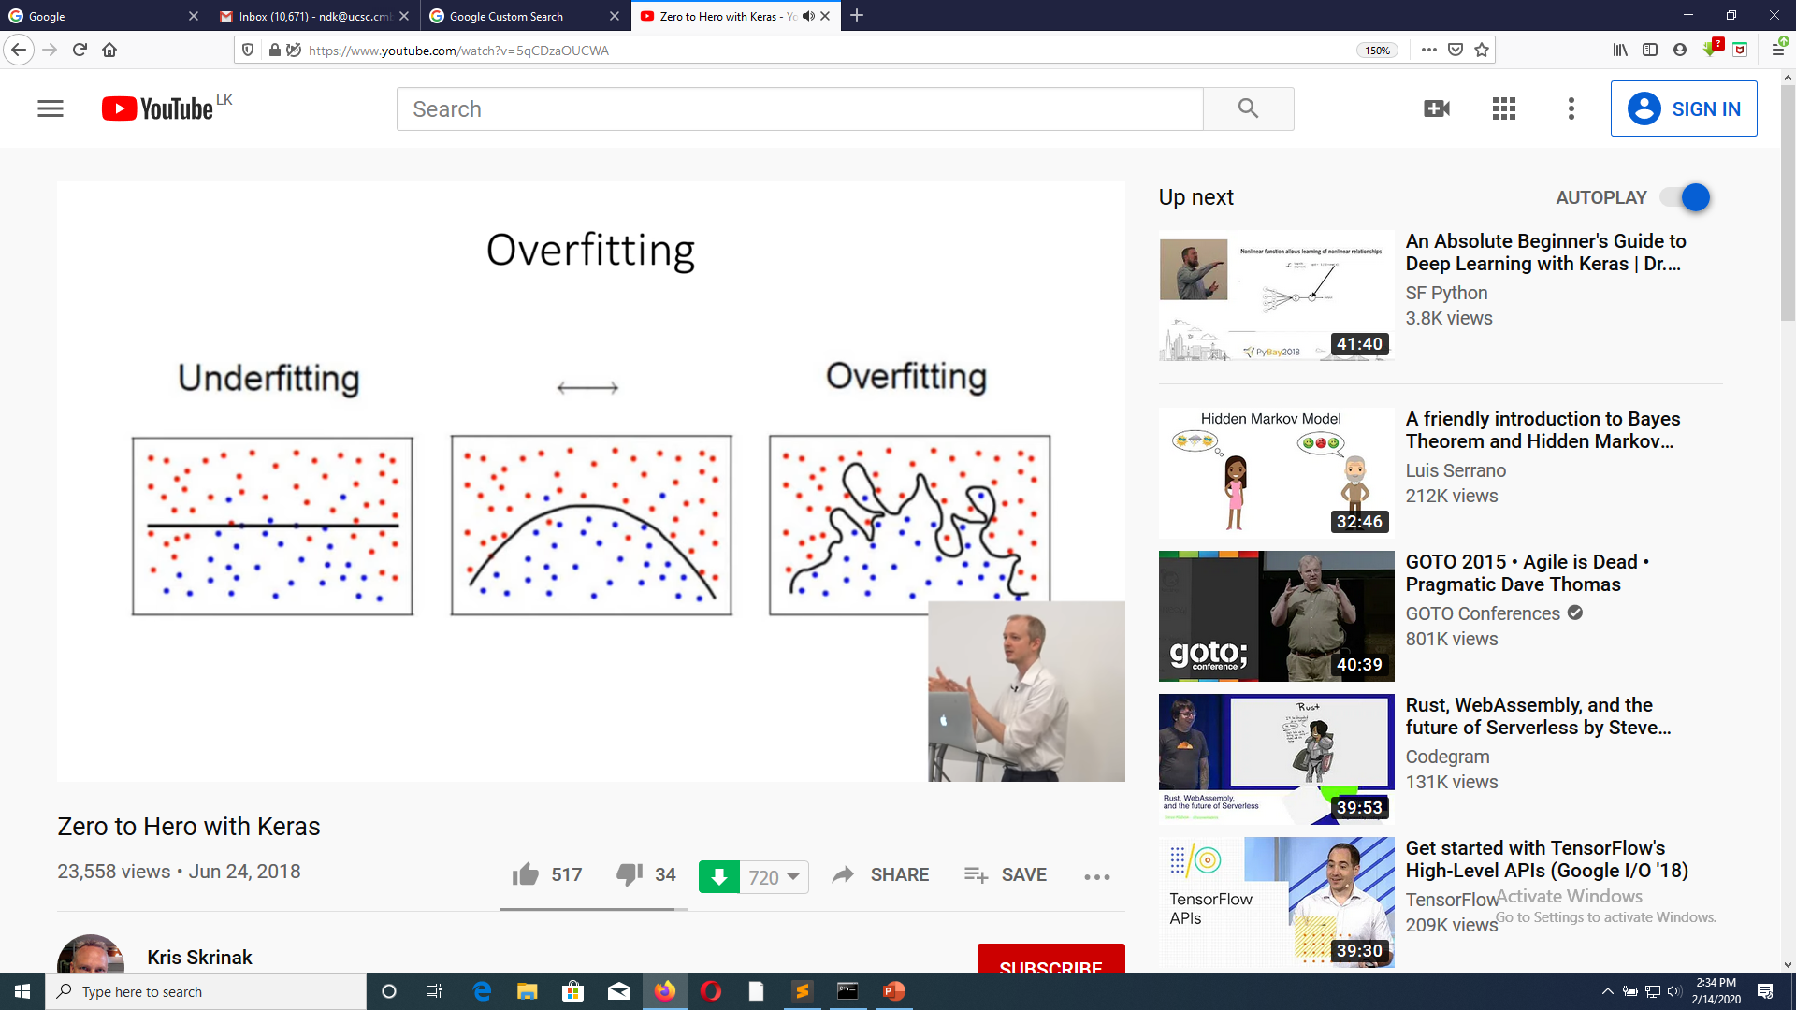

Slide 73
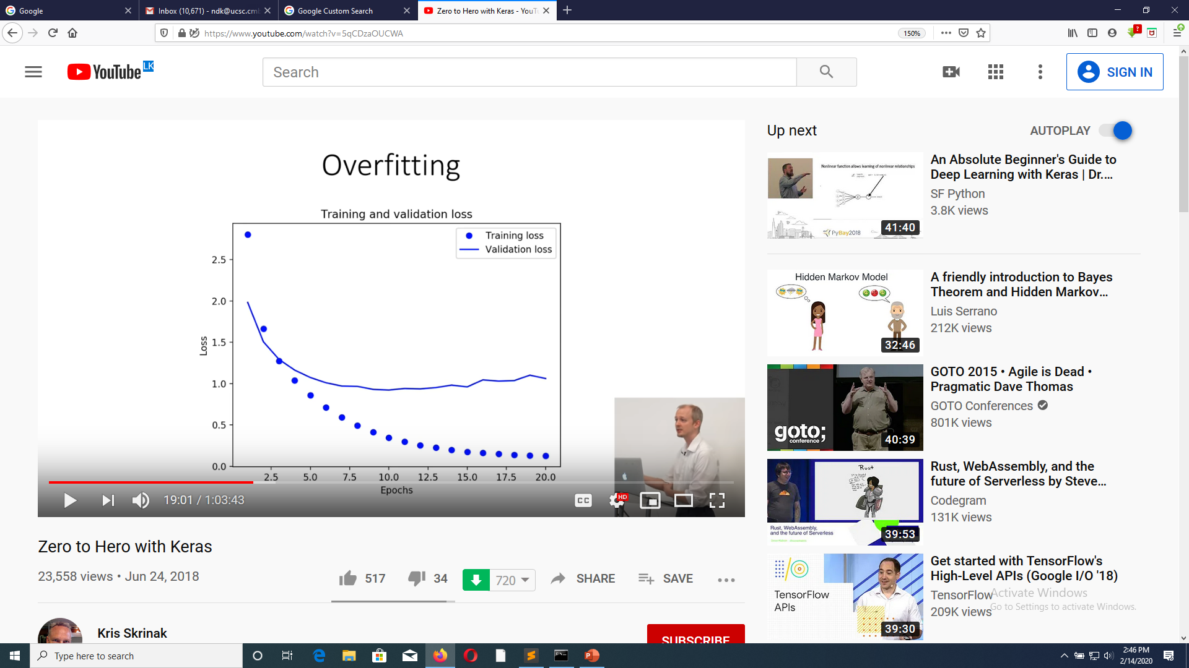

Slide 74
Regularization Techniques
Early Stopping
L1 and L2 Regularization
Dropouts
Max-Norm Regularization
Data Augmentation

Slide 75
Regularization Techniques
Early Stopping
L1 and L2 Regularization
Dropouts
Max-Norm Regularization
Data Augmentation

Slide 76
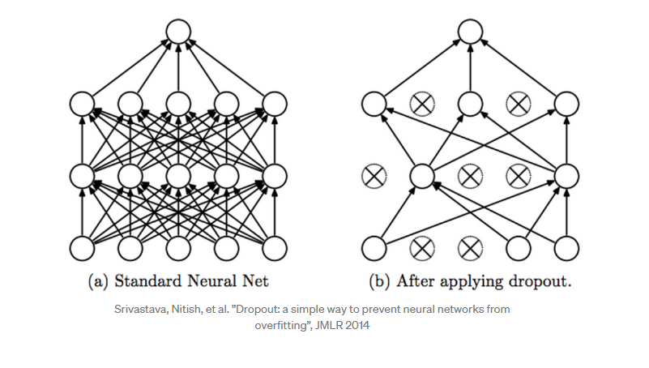

Slide 77
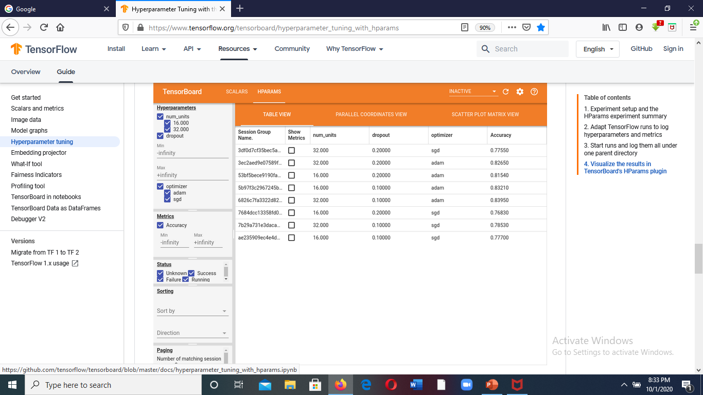

Slide 78


Slide 79



Slide 80





Slide 81


Slide 82


Slide 83

Exercise - Build a CNN with two convolution layers to classify MINST hand written digits data
Data Set – MINST handwritten digits with 60,000 training images and 10,000 testing images (28,28)

Slide 84


Slide 85
Some CNN Architectures/Models
There are various architectures of CNNs available which have been key in building algorithms which power and shall power AI as a whole in the foreseeable future. Some of them have been listed below:
AlexNet
VGGNet
GoogLeNet
ResNet
ZFNet

Slide 86


The ResNet Architecture

Slide 87
Using Pre-Trained Models for Image Classification
VGG16
VGG16 is a convolutional neural network model proposed by K. Simonyan and A. Zisserman from the University of Oxford in the paper “Very Deep Convolutional Networks for Large-Scale Image Recognition”.
The VGG16 architecture consists of thirteen convolutional layers, some of which are followed by maximum pooling layers and then four fully-connected layers and finally a 1000-way softmax classifier.
The model achieves 92.7% top-5 test accuracy in ImageNet, which is a dataset of over 1.5 million images belonging to 1000 classes. It was one of the famous model submitted to ILSVRC-2014. It makes the improvement over AlexNet by replacing large kernel-sized filters (11 and 5 in the first and second convolutional layer, respectively) with multiple 3×3 kernel-sized filters one after another. VGG16 was trained for weeks and was using NVIDIA Titan Black GPU’s.
https://neurohive.io/en/popular-networks/vgg16/

Slide 88


Slide 89
Tensorflow 2.0 Keras code
from __future__ import absolute_import, division, print_function, unicode_literals
import tensorflow as tf
from tensorflow import keras
from tensorflow.keras.applications.vgg16 import VGG16,preprocess_input, decode_predictions
from tensorflow.keras.preprocessing.image import load_img, img_to_array
model=VGG16()
model.summary()
import os
for file in os.listdir('C:\samples'):
print (file)
full_path = 'C:\samples/' +file
print (full_path)
image = load_img(full_path, target_size=(224,224))
image = img_to_array(image)
image = image.reshape (1, image.shape[0], image.shape[1], image.shape[2])
image = preprocess_input(image)
y_pred = model.predict(image)
label = decode_predictions(y_pred, top=2)
print (label)
print()

Slide 90


Slide 91

Fully Convolutional Networks (FCN)
A fully convolutional neural network is like a convolutional neural network but without any fully connected layers ie. it is comprised purely of convolutional layers and maybe some max-pooling layers. This means that the output of the network is an image as the output layer is a convolutional layer

Slide 92


Slide 93
Upsampling or Unspooling
1 | 2
3 | 4
1 | 1 | 2 | 2
1 | 1 | 2 | 2
3 | 3 | 4 | 4
3 | 3 | 4 | 4
Nearest Neighbour
1 | 0 | 2 | 0
0 | 0 | 0 | 0
3 | 0 | 4 | 0
0 | 0 | 0 | 0
1 | 2
3 | 4
Bed of Nails

Slide 94
Max Unspooling
1 | 2 | 6 | 3
3 | 5 | 2 | 1
1 | 2 | 2 | 1
7 | 3 | 4 | 8
0 | 0 | 2 | 0
0 | 1 | 0 | 0
0 | 0 | 0 | 0
3 | 0 | 0 | 4
5 | 6
7 | 8
………
1 | 2
3 | 4

Slide 95

Transpose Convolution
S5
= 0*2+0*1+0*2 + 0* 0+0*1+0*0 + 0*3+0*2+1*1
= 1

Slide 96


Slide 97


Slide 98


Slide 99
Data Augmentation Techniques
When the training data set is small more training images can be added using
Horizontal Flips -
Random crops/ scales -
Colour Jitters
Geometric changes

Slide 100

hflipped_image = tf.image.flip_left_right(image)

Slide 101


Slide 102


Slide 103


Slide 104


Data Augmentation Flipping

Slide 105

Answer 5x5

Slide 106



Slide 107




Slide 108
Dilated Convolution
Dilated convolutions support exponentially expanding receptive fields without losing resolution or coverage.

Slide 109

Standard 2D Convolution (l=1)

Slide 110

Dilated Convolution (l=2)

Slide 111

Dialation rate
l=1 l=2 l=4
Receptive field
3x3 7x7 15x15

Slide 112


Slide 113

Image Inpainting

Slide 114



A problem with CNN

Slide 115

Transformers for Image Recognition
https://arxiv.org/pdf/2010.11929.pdf

Slide 116
Transfer Learning
Transfer learning is a machine learning technique where a model trained on one task is re-purposed on a second related task.
For example the reuse of a pre-trained model on a different problem. It’s a technique very popular in Deep Learning and it allows you to train a deep neural network with a small dataset.
In addition, it’s very difficult to find good labelled data to train such complex models, for that reason it is recommend to use pre-trained models for your image classification projects.
However, Transfer learning only works in deep learning if the model features learned from the first task are general.
 | # load model without classifier layers model = VGG16(include_top=False, input_shape=(300, 300, 3))

Slide 117
Deep Learning based Detection Techniques
Sliding Window
R-CNN
Fast R-CNN
Faster R-CNN
Mask R-CNN
YOLO
Retina Net

Slide 118


Recurrent Neural Networks (RNN)
RNN can model sequential information.
RNN based video processing :
Continuous video classification
Video analysis
Action recognition using Bi-directional RNN
Video based emotional recognition
Video prediction
Image captioning
Language translation
Predictions : stock market, weather
LSTM (Long Short-Term Memory)
Can store information for longer periods of time

Slide 119

Generating Image Descriptions
Together with convolutional Neural Networks, RNNs have been used as part of a model to generate descriptions for unlabeled images. It’s quite amazing how well this seems to work. The combined model even aligns the generated words with features found in the images.
Deep Visual-Semantic Alignments for Generating Image Descriptions. Source: http://cs.stanford.edu/people/karpathy/deepimagesent/

Slide 120

Generative Adversarial Networks (GAN)
Generative adversarial networks (GANs) are algorithmic architectures that use two neural networks, pitting one against the other (thus the “adversarial”) in order to generate new, synthetic instances of data that can pass for real data.
They are used widely in image generation, video generation and voice generation.
Illustration of GANs abilities by Ian Goodfellow and co-authors. These are samples generated by Generative Adversarial Networks after training on two datasets: MNIST and TFD. For both, the rightmost column contains true data that are the nearest from the direct neighboring generated samples. This shows us that the produced data are really generated and not only memorised by the network. (source: “Generative Adversarial Nets” paper), 2014

Slide 121


Example of the Progression in the Capabilities of GANs From 2014 to 2017.
Class conditional examples generated from Large Scale GAN Training for High Fidelity Natural Image Synthesis

Slide 122


Slide 123

Here are the steps a GAN takes:
The generator takes in random numbers and returns an image.
This generated image is fed into the discriminator alongside a stream of images taken from the actual, ground-truth dataset.
The discriminator takes in both real and fake images and returns probabilities, a number between 0 and 1, with 1 representing a prediction of authenticity and 0 representing fake.
So you have a double feedback loop:
The discriminator is in a feedback loop with the ground truth of the images, which we know.
The generator is in a feedback loop with the discriminator.

Slide 124


Slide 125


Slide 126

Video Generation from Text
Yitong Li,†∗Martin Renqiang Min,‡Dinghan Shen,†David Carlson,†Lawrence Carin††Duke University, Durham, NC, United States, 27708‡NEC Laboratories America, Princeton, NJ, United States, 08540{yitong.li, dinghan.shen, david.carlson, lcarin}@duke.edu, renqiang@nec-labs.com

Slide 127
|||||||…..||| ||…|||
Fever (90) Covid (10)
TP - Model correctly predicted Covid = 1
TN – Model correctly predicted Fever = 90
FP - Model incorrectly predicted Covid = 1
FN – Model incorrectly predicted Fever = 8
Accuracy = TP+TN = 0.91
TP+TN+FP+FN
FN = ?
Calculate Precision, Recall, F1 Score, Confusion Matrix

Slide 128
Some examples of technology which currently rely on deep learning:
Virtual Assistants e.g. Siri, Google Assistant, Alexa, Cortana
Recommendations e.g. movies on Netflix, pages on Facebook,
music on Spotify
Facial recognition e.g. auto tagging of contacts on iPhone and
Facebook
Translating languages e.g. Google Translate, DeepL Translator
Fraud detection in banking and finance
Self-driving cars e.g. Waymo, Tesla

Slide 129


